Slide 1

Inventory Check
Computing Project - 12/06/2020
Supervisor: Dr. Edward Anstead

Slide 2
Motivation
From research:
Lack of suitable system.
Use spreadsheet to manage their stocks.
Old techniques in use e.g. Record in a piece of paper

Slide 3
Scope
Build system to manage their inventory stock.
Store data in the database.
Retrieve information when needed.
Analyse the data in backend and display them in chart view.

Slide 4
Design
Use Case Diagram
Wireframe 1 and 2
Final front-end design

Slide 5
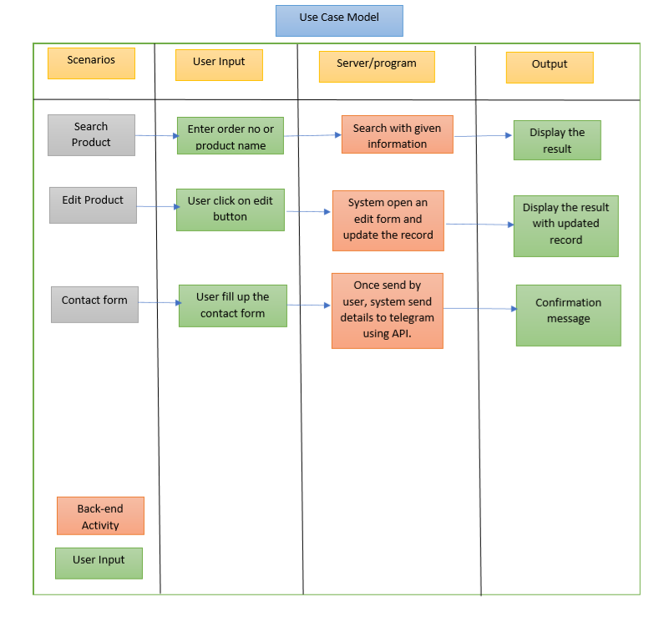

Slide 6
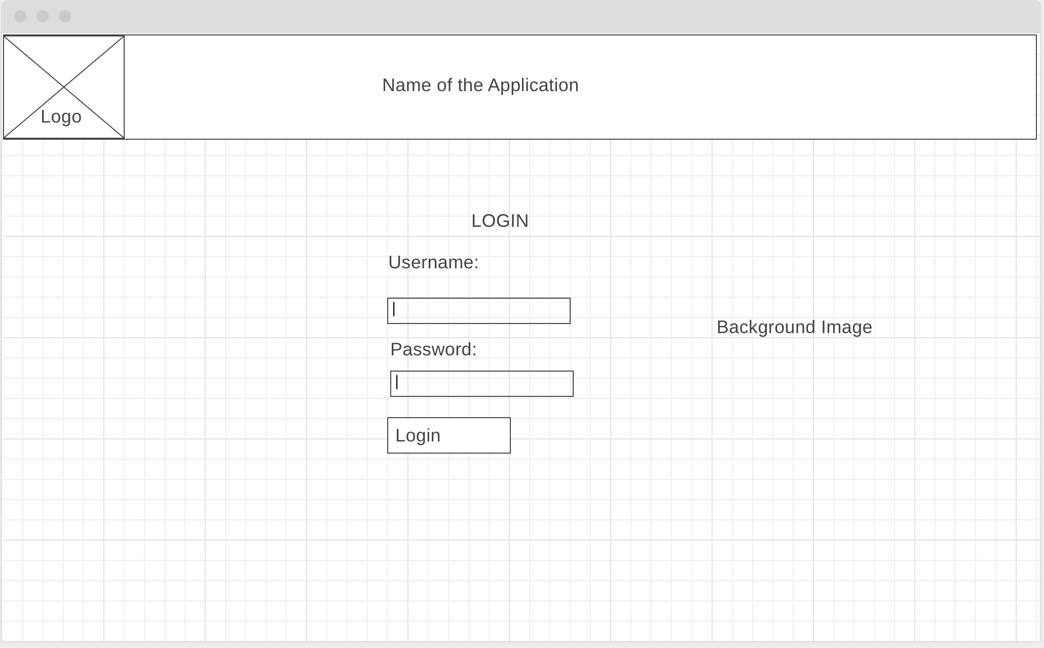
Wireframe 1 - Homepage

Slide 7
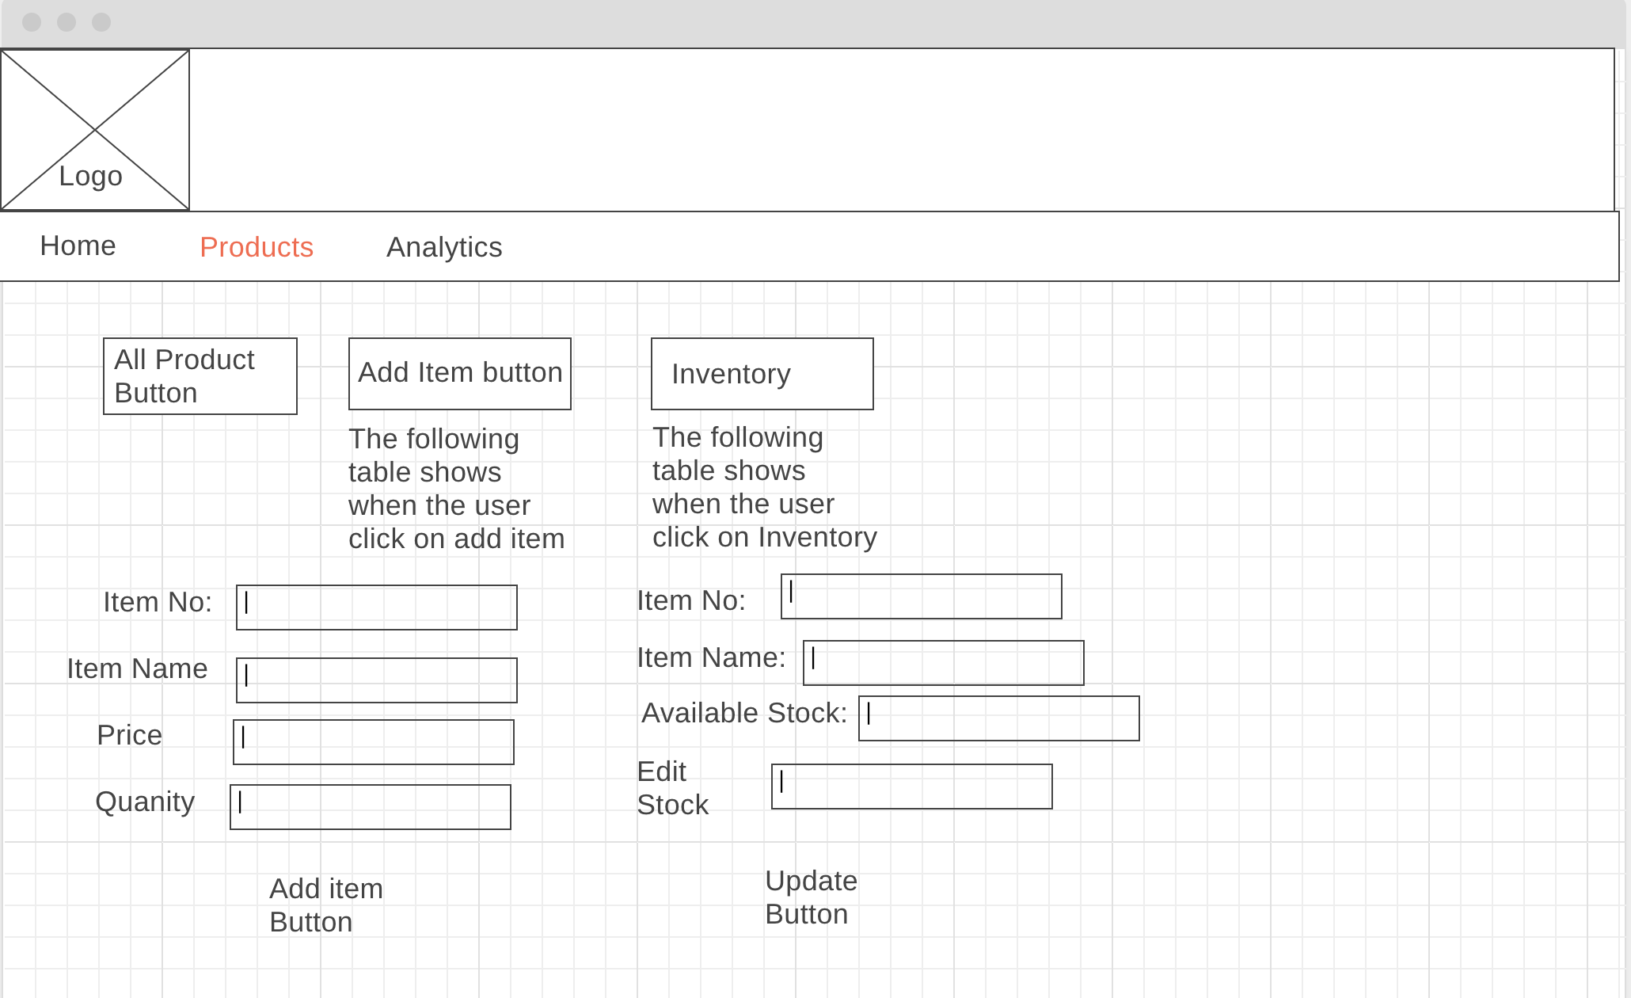
Wireframe 1 - Product

Slide 8
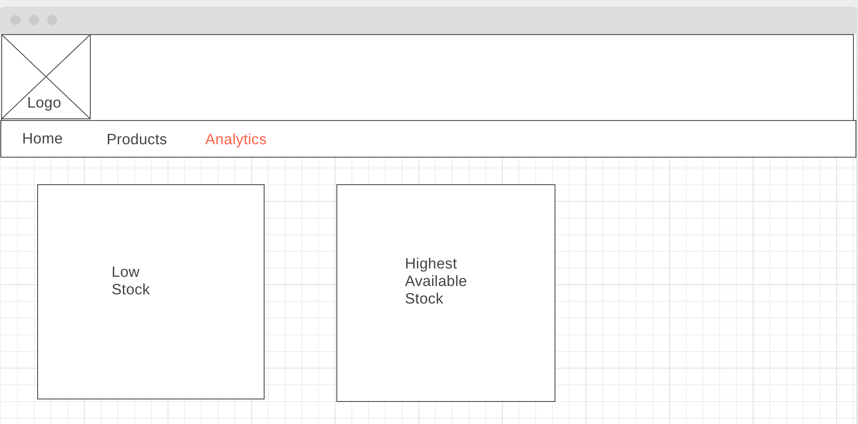
Wireframe 1 - Analytic

Slide 9
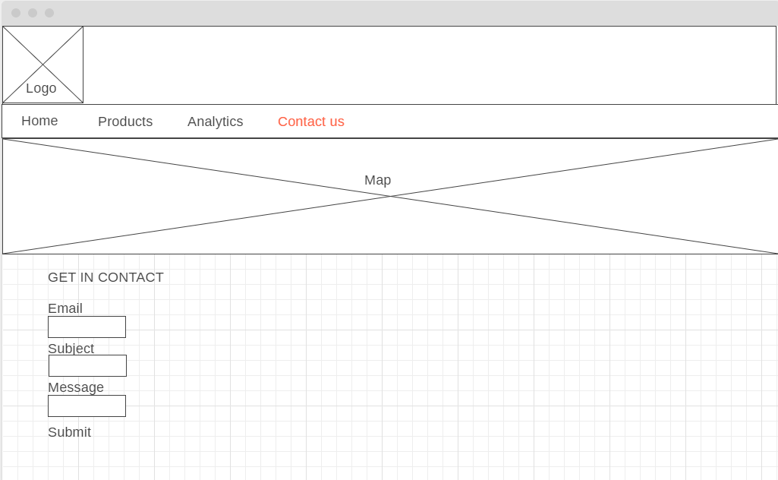
Wireframe 1 - Contact us

Slide 10
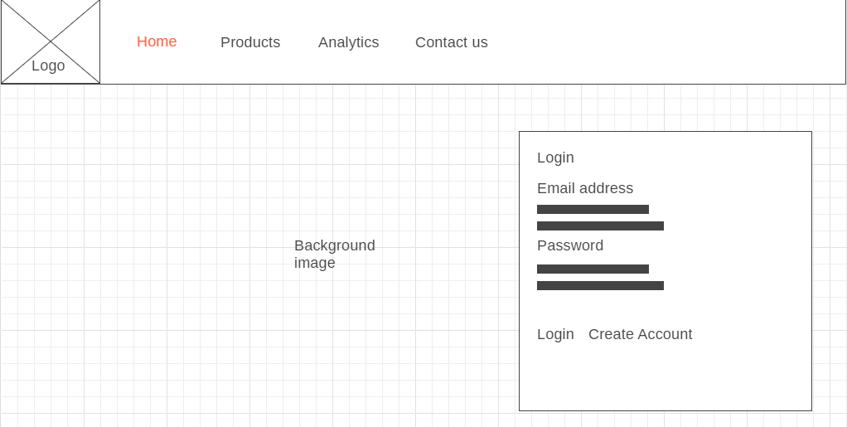
Wireframe 2 - Homepage

Slide 11
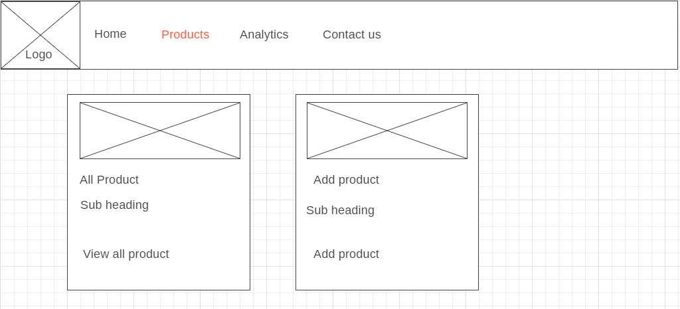
Wireframe 2 - Product

Slide 12
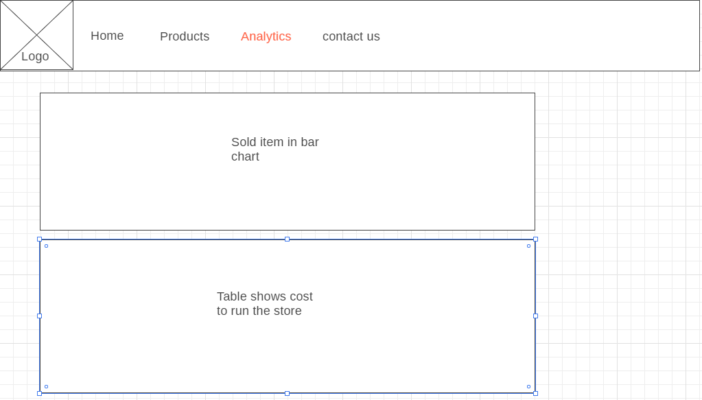
Wireframe 2 - Analytic

Slide 13
Wireframe 2 - Contact us

Slide 14
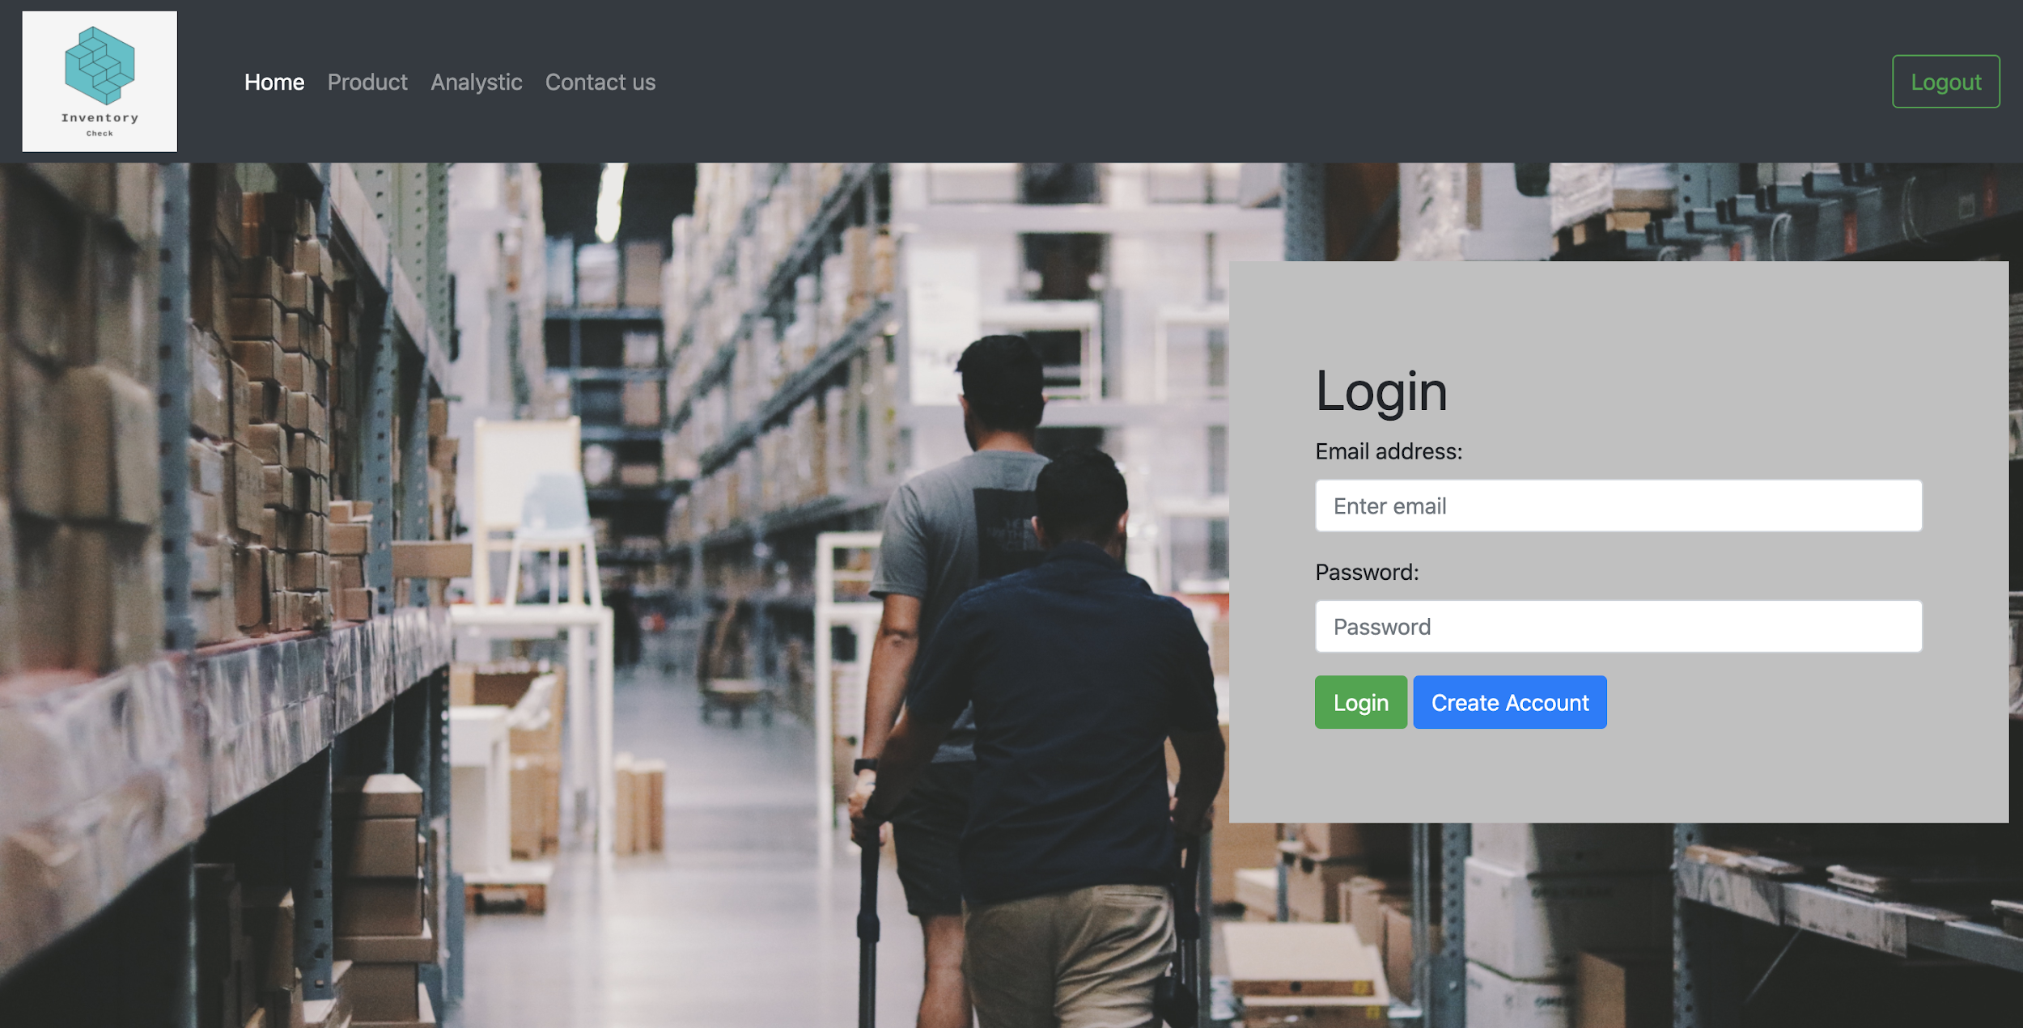
Final front-end design - Homepage

Slide 15
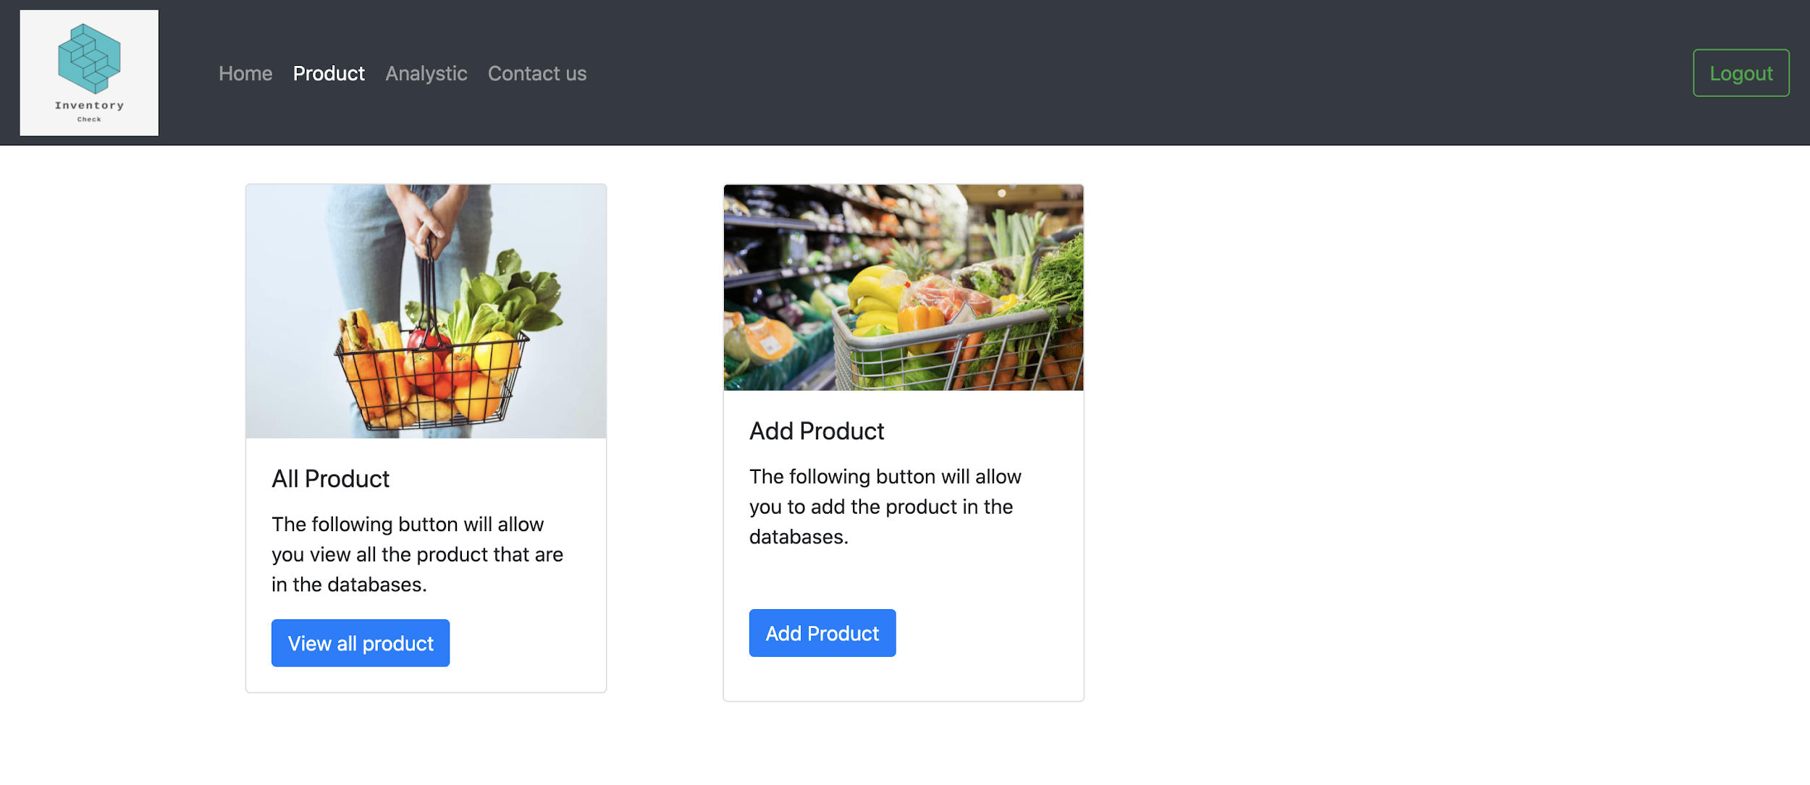
Final front-end design - Product

Slide 16
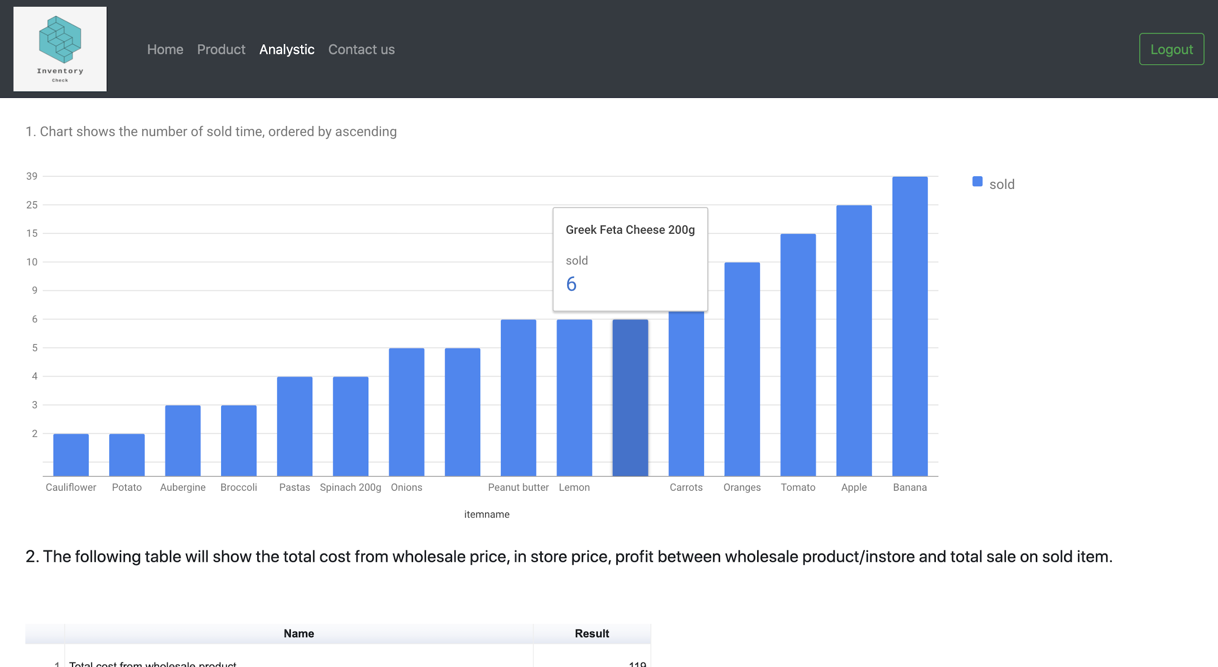
Final front-end design - Analytics

Slide 17
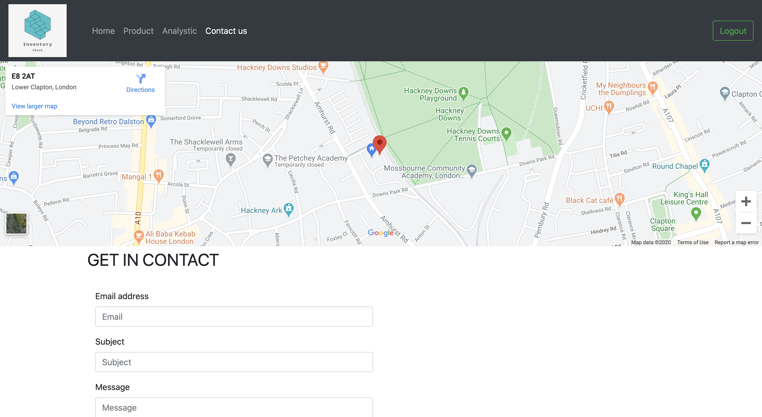
Final front-end design - Contact us

Slide 18
Development & Testing
Developed using various programming language such as HTML, CSS, JavaScript, MySQL, API and PHP.
Use of Gantt Chart.
Testing approach
Normal Testing
User testing

Slide 19
Evaluation
High technical standard in front-end and back-end of the system
Good use of gantt chart to keep on going with the current tasks.
Stable system to help the local shopkeeper.
Good feedback from my uncle and other shopkeeper.

Slide 20
Any Questions?

